Slide 1
HAHAHA
Very
Funny

Slide 2
Really Guy’s? How old are you?

Slide 3
Ouch that really hurt.
My Head Hurts.
Sorry I can’t go out today. I don’t feel well.
I’m so Tired.

Slide 4
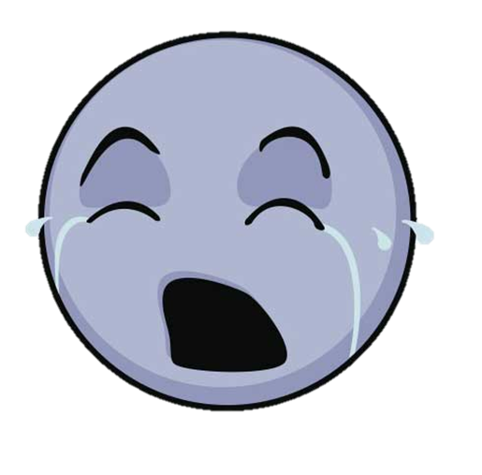
Please STOP!
It Hurts!
GO AWAY!

Slide 5
Does Experiencing Discrimination Negatively Impact Health?

Slide 6
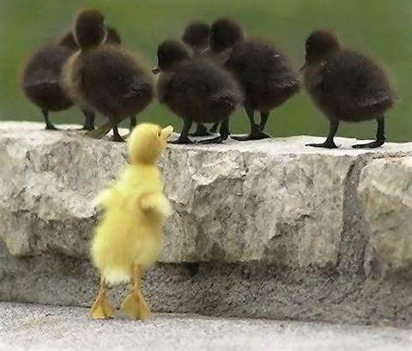
My Perspective: Does Experiencing Discrimination Negatively Impact Physical Health?
Nazi
Gay
Black
Terrorist
Girl
Lesbian

Slide 7
“The practice of unfairly treating a person or group differently from other people or groups of people.”

Slide 8
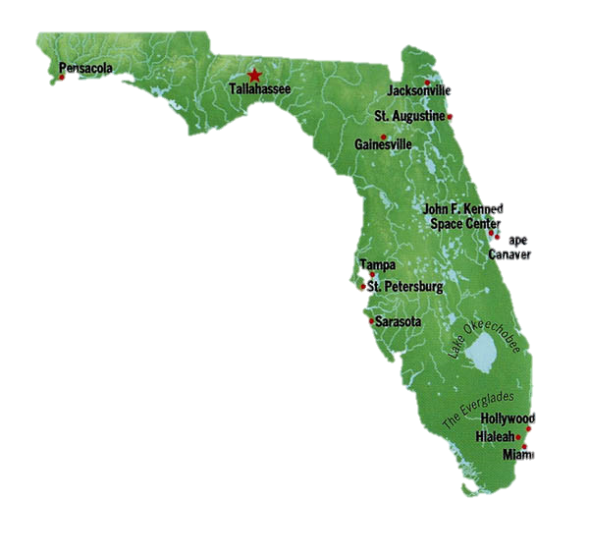

Slide 9
Does Experiencing Discrimination Negatively Impact Physical Health?

Slide 10
Experiencing Discrimination
Thesis
Causes Illnesses
Influences Unhealthy Habits
Lead to Additional Health Risks

Slide 11
Discriminated Group Requires Aid
Concession
Positive Discrimination Initiates
Discriminated Group Receives Aid

Slide 12
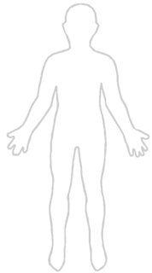
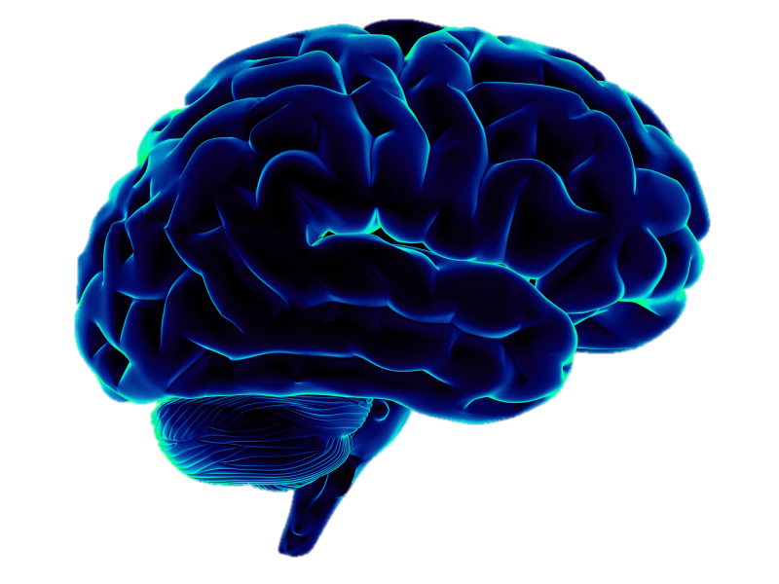
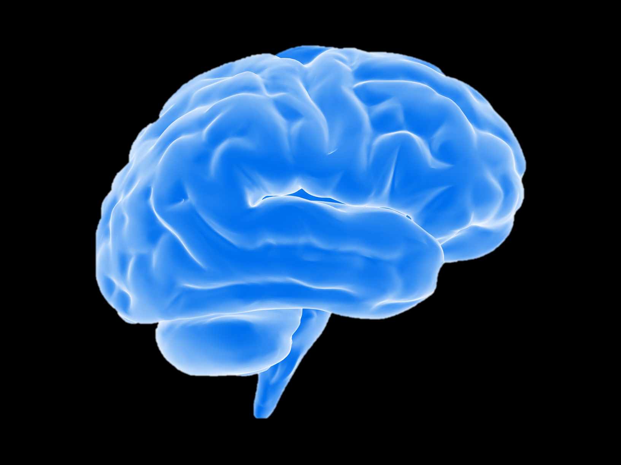
STRESS
STRESS
STRESS

Slide 13
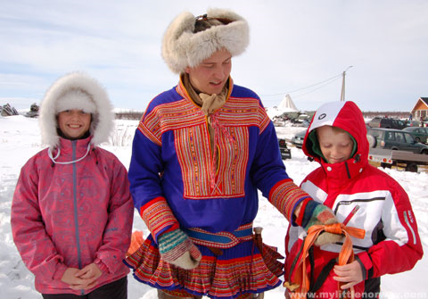
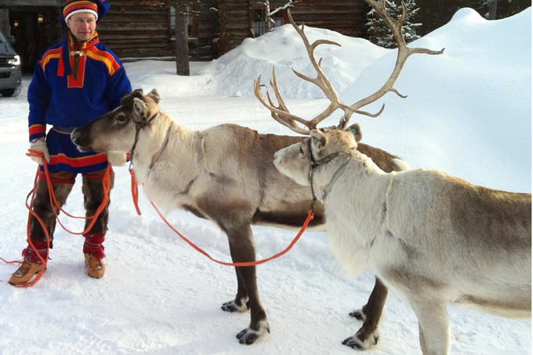
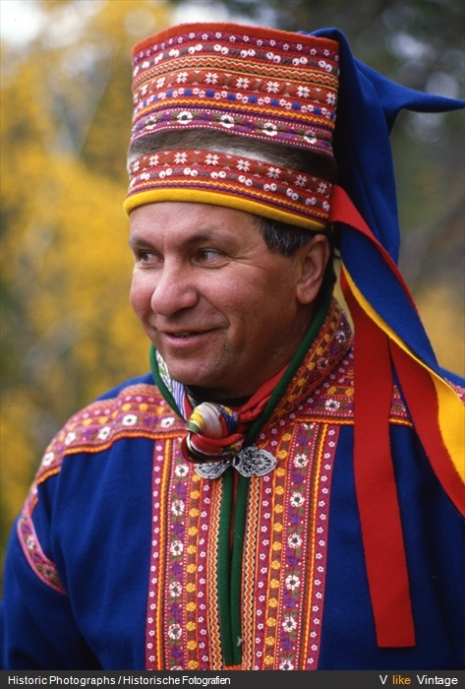
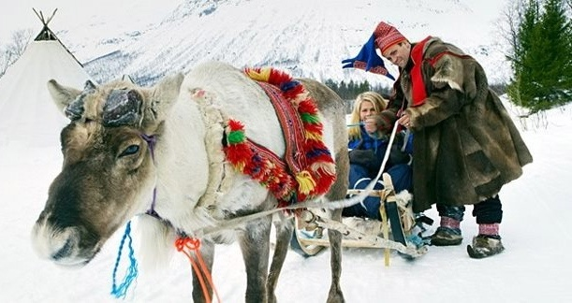
(Things you didn’t know about reindeer,2013)
(Ethnic groups in Lapland,2016)
(Pinterest,2016)
(Pinterest, 2016)

Slide 14
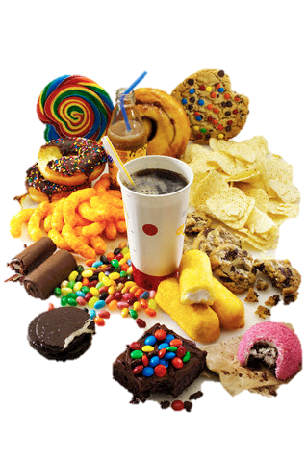
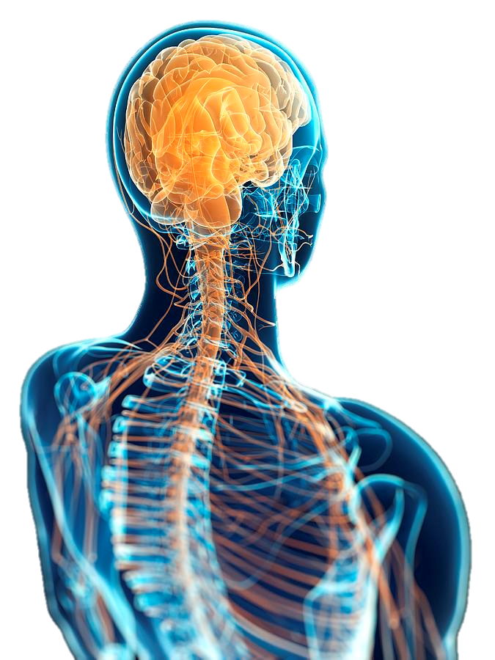
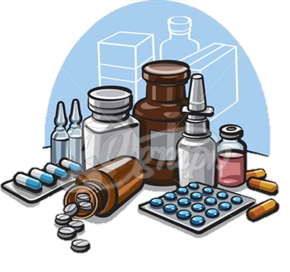
STRESS
Unhealthy Habits

Slide 15
Immigrant
Black
Family
Friends
Lesbian
Hate
Support
Love
Nazi
Wonderful
Beautiful
Disabled
Kind
Happy
Gay
Old

Slide 16
However there is positive or good discrimination that aids individuals who are seen as discriminated groups!

Slide 17
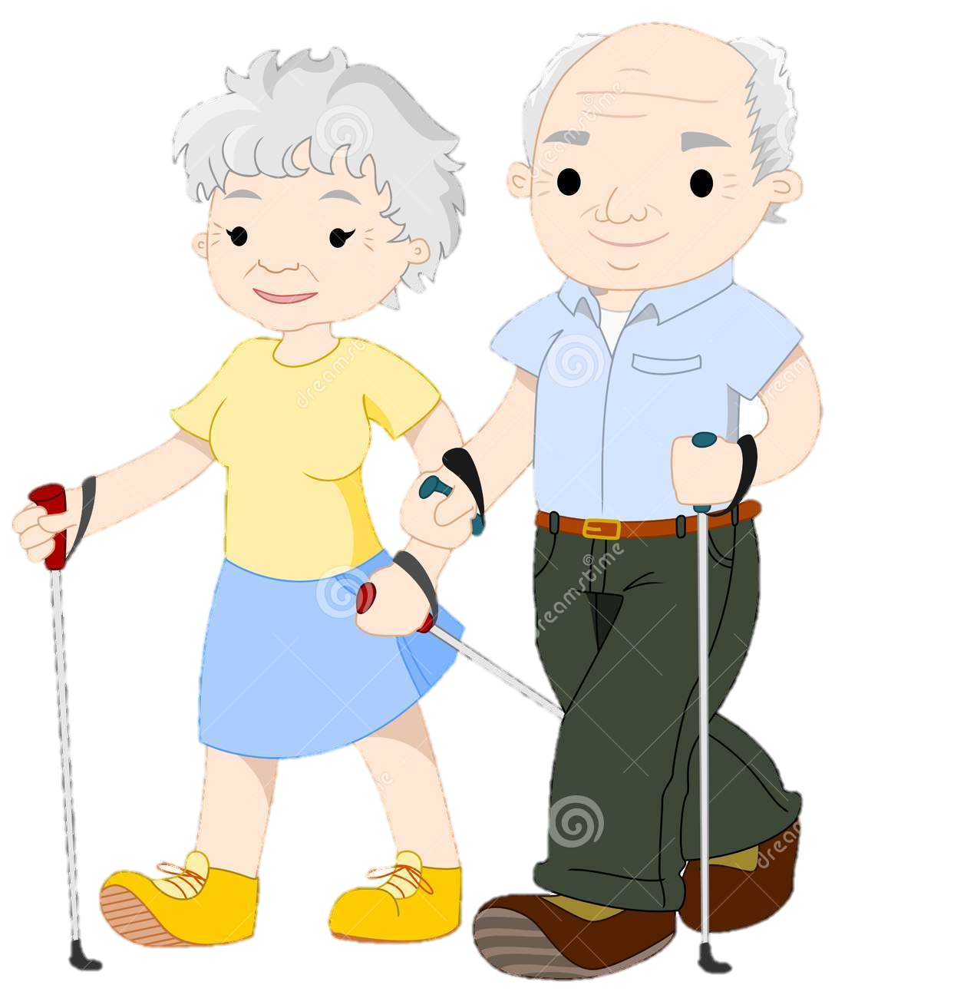
Age Discrimination act
Providing Beneficial Aid
Helps
By

Slide 18
Experiencing Discrimination
Discriminated Groups Require Aid
Causes Illness
Positive Discrimination Initiates
Influences Unhealthy Habits
Discriminated Group Receives Aid
Lead to Additional Health Risks

Slide 19
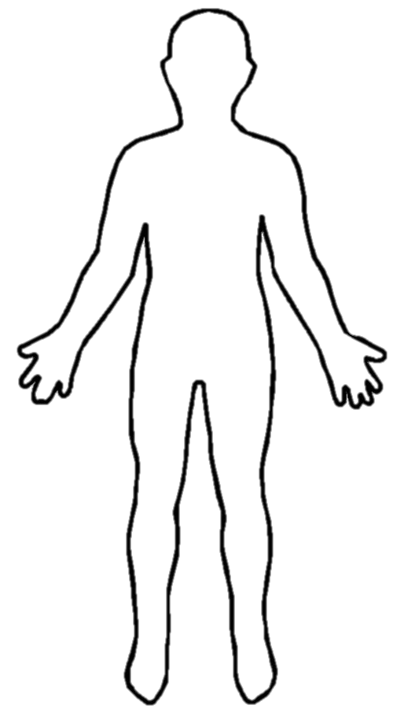
It starts with you!
Stress
&
Discrimination

Slide 20
References
Australian Human Rights Commission. (2016, April 19). Retrieved April 19, 2016, from https://www.humanrights.gov.au/quick-guide/12078
Ethnic groups in Lapland. (n.d.). Retrieved May 09, 2016, from http://www.snipview.com/q/Ethnic_groups_in_Lapland?alt=Ethnic_groups_in_lapland
Gibbons, F. X., Kingsbury, J. H., Weng, C., Gerrard, M., Cutrona, C. E., & Wills, T. A. (2014, January). Effects of perceived racial discrimination on health status and health behavior: A differential mediation hypothesis [Scholarly project]. In Iastate.edu. Retrieved April 19, 2016, from http://lib.dr.iastate.edu/cgi/viewcontent.cgi?article=1002&context=psychology_pubs
Gilhooley, D. (2008, December 29). Positive discrimination and positive action. Retrieved April 19, 2016, from https://www.timeshighereducation.com/news/positive-discrimination-and-positive-action/404799.article
Hansen, K. L. (2015). Ethnic discrimination and health: The relationship between experienced ethnic discrimination and multiple health domains in Norway's rural Sami population. Retrieved April 19, 2016, from http://www.circumpolarhealthjournal.net/index.php/ijch/article/view/25125
Kolarcik, P., Geckova, A. M., Reijneveld, S. A., & Van Dijk, J. P. (2015, November 19). International Journal for Equity in Health. Retrieved April 19, 2016, from http://equityhealthj.biomedcentral.com/articles/10.1186/s12939-015-0270-z
Merriam-Webster. Merriam-Webster, 10 May 2016. Web. 10 May 2016. http://www.merriam-webster.com/dictionary/discrimination.
Pinterest. (n.d.). Retrieved from https://www.pinterest.com/pin/110760472056524138/
Things you didn’t know about reindeer. (2013). Retrieved May 09, 2016, from http://newpittsburghcourieronline.com/2013/12/24/things-you-didnt-know-about-reindeer/

